Slide 1
MY PRIVACY MY DECISION:
Name: UMMU HABEEBA T
20MCA11058
Product Owner:
Prof.Balachandran KP

Slide 2
Table Of Contents:
1. Introduction
2. Modules
3.Methodology
4. Developing Environment
5.Project plan
6.User story
7. Product backlog
8. Sprint plan
9.Sprint Actual
10. Screenshots

Slide 3
My Privacy My Decision
Photo sharing is an attractive feature which popularizes online social networks (OSNs).
Unfortunately, it may leak users’ privacy if they are allowed to post, comment, and tag a photo freely.
In this project, we attempt to address this issue and study the scenario when a user shares a photo containing individuals other than himself/herself (termed co-photo for short)
we design a mechanism to enable each individual in a photo be aware of the posting activity and participate in the decision making on the photo posting
we need an efficient facial recognition (FR) system that can recognize everyone in the photo

Slide 4
MODULES
1.Admin
Registration
Login
Administration
2. User
Registration
Login
Manage profile , Post & Friends
Chat
Can Decide their Photo Privacy

Slide 5
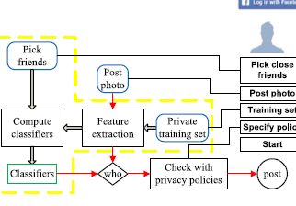
METHODOLOGY

Slide 6
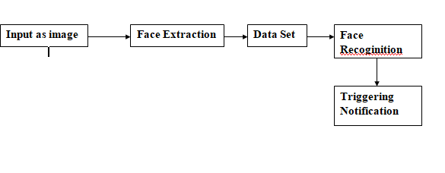
General Working

Slide 7
Technical Steps
Dataset Preperation
Preprocessing
Face Detection using Haarcascade FrontFace Detection (Feature Extraction Method)
Face Recoginition Using CNN [Periocular Based Approach (Extract Feature Points)]
Calculating & Comparing Eigen Distance Using SVM classification
Labeling Match Profile
Triggering Notification
Post Photo Based on User Decision

Slide 8
Haar Cascade Face Detection
Haar Cascade is a machine learning-based approach where a lot of positive and negative images are used to train the classifier. Positive images – These images contain the images which we want our classifier to identify. Negative Images – Images of everything else, which do not contain the object we want to detect
It is an Object Detection Algorithm used to identify faces in an image or a real time video.

Slide 9
CNN
A Convolutional Neural Network (ConvNet/CNN) is a Deep Learning algorithm which can take in an input image, assign importance (learnable weights and biases) to various aspects/objects in the image and be able to differentiate one from the other. The pre-processing required in a ConvNet is much lower as compared to other classification algorithms. While in primitive methods filters are hand-engineered, with enough training, ConvNets have the ability to learn these filters/characteristics.
Image classification involves the extraction of features from the image to observe some patterns in the dataset. Using an ANN for the purpose of image classification would end up being very costly in terms of computation since the trainable parameters become extremely large.

Slide 10
SVM
A support vector machine is a machine learning model that is able to generalise between two different classes if the set of labelled data is provided in the training set to the algorithm. The main function of the SVM is to check for that hyperplane that is able to distinguish between the two classes. There can be many hyperplanes that can do this task but the objective is to find that hyperplane that has the highest margin that means maximum distances between the two classes, so that in future if a new data point comes that is two be classified then it can be classified easily. An SVM model is basically a representation of different classes in a hyperplane in multidimensional space. The hyperplane will be generated in an iterative manner by SVM so that the error can be minimized. The goal of SVM is to divide the datasets into classes to find a maximum marginal hyperplane (MMH).
The followings are important concepts in SVM :
Support Vectors − Datapoints that are closest to the hyperplane is called support vectors.
Separating line will be defined with the help of these data points.
Hyperplane − As we can see in the above diagram, it is a decision plane or space which is divided between a set of objects having different classes.
Margin − It may be defined as the gap between two lines on the closet data points of different classes. It can be calculated as the perpendicular distance from the line to the support vectors.

Slide 11
Developing Environment
Hardware Requirements:
Processor: i3
Hard Disk: 500 GB
RAM: 4 GB
Software Requirements:
Language: Python
Front End: Python- django
Back end: SQlite
Techniques Used: CNN,SVM .
IDE: pycharm,Anaconda Navigator
OS: Windows/Linux

Slide 12
User Story
User Story ID | As a <Type Of User> | I Want to <Perform some Task> | So That I Can <Achieve Some Goal>
1 | User | UI Creation Model creation(Registration & Login form) | Create Reg & Login
2 | User | Home Page Creation | Create Home Page for Social Media
3 | User | Manage Post (Add/Delete/Edit/View) | Can Manage Post
4 | User | UI Creation (Send/Manage Friend Request) | Can Manage Friends
5 | User | Manage Post (Add/Delete/Edit/View) | Can Manage Post
6 | User | Prepare Dataset From Profile | Dataset
7 | User | Front Face Detection & Recoginition | Face
8 | User | Calculate Eigen Distance | Eigen distance
9 | User | Classification using SVM | Label of match
10 | User | Sending Notification to user | Notification
11 | User | Check user Decision | Y / N
12 | User | If Y post The picture Otherwise doesn’t post | Posting to the wall

Slide 13
Product Backlog
User story ID | Priority<High/ medium/Low> | Size(hours) | Sprint<#> | Status<Planned /In progress/ Completed> | Release Date | Release Goal
1 | Medium | 2 | 1 | Completed | 28/05/2022 | UI Creation Model creation(Registration & Login form)
2 | medium | 5 |  | Completed | 29/05/2022 | Home Page Creation
3 | High | 3 |  | Completed | 29/05/2022 | Manage Post (Add/Delete/Edit/View)
4 | Medium | 3 | 2 | Completed | 01/05/22 | UI Creation (Send/Manage Friend Request)
5 | Medium | 2 |  | Completed | 02/05/22 | Manage Post (Add/Delete/Edit/View)
6 | Medium | 5 |  | Completed | 04/05/22 | Prepare Dataset From Profile
7 | Medium | 5 | 3 | Completed | 21/05/22 | Front Face Detection & Recoginition
8 | Medium | 5 |  | Completed | 30/05/22 | Calculate Eigen Distance
9 | Medium | 5 | 4 | Completed | 03/06/22 | Classification using SVM
10 | High | 5 |  | Completed | 05/06/22 | Sending Notification to user
11 | High | 5 |  | Completed | 26/06/22 | Check user Decision
12 | High | 5 |  | Completed | 30/06/22 | If Y post The picture Otherwise doesn’t post

Slide 14
Project Plan
User Story ID | Task Name | Start Date | End Date | Days | Status
1 | Sprint 1 | 28/04/22 | 28/04/22 | 2 | completed
2 |  | 28/04/22 | 28/04/22 |  | completed
3 |  | 29/04/22 | 29/04/22 |  | completed
4 | Sprint 2 | 01/05/22 | 02/05/21 | 4 | completed
5 |  | 02/05/22 | 03/05/22 |  | completed
6 |  | 03/05/22 | 04/05/22 |  | completed
7 | Sprint 3 | 20/05/22 | 21/05/22 | 4 | completed
8 |  | 29/05/22 | 30/05/22 |  | completed
9 | Sprint 4 | 03/06/22 | 03/06/22 | 6 | Completed
10 |  | 05/06/22 | 05/06/22 |  | Completed
11 |  | 25/06/22 | 26/06/22 |  | Completed
12 |  | 29/06/22 | 30/06/22 |  | Completed

Slide 15
SPRINT PLAN
Backlog item | Status & Completion date | Original Estimate in hours | Day 1 | Day 2 | Day 3 | Day 4 | Day 5 | Day 6 | Day 7 | Day 8 | Day 9 | Day 10 | Day 11 | Day 12
User Story#1,2,3 |  |  | Hours | Hours | Hours | Hours | Hours | Hours | Hours | Hours | Hours | Hours | Hours | Hours
Data set creation | 29/04/22 | 2 | 2 | 0 | 0 | 0 | 0 | 0 | 0 | 0 | 0 | 0 | 0 | 0
Ranking | 04/05/22 | 8 | 3 | 0 | 3 | 0 | 2 | 0 | 0 | 0 | 0 | 0 | 0 | 0
User story #4,5,6
UI designing & Manage post | 30/05/22 | 10 | 1 | 1 | 1 | 1 | 1 | 1 | 1 | 1 | 1 | 1 | 0 | 0
User story #7,8
Design Correction after Integration | 26/06/2022 | 10 | 2 | 1 | 1 | 1 | 1 | 1 | 0 | 0 | 0 | 1 | 1 | 1
User story #9,10,11
Output | 30/06/22 | 20 | 2 | 2 | 2 | 1 | 2 | 1 | 2 | 2 | 2 | 1 | 2 | 1
Total |  | 50 | 10 | 4 | 7 | 3 | 6 | 3 | 3 | 3 | 3 | 3 | 3 | 2
Backlog Item | Status and Completion date | Original Estimate in hours | Day 1 | Day 2 | Day 3 | Day 4 | Day 4 | Day 5 | Day 6 | Day 7 | Day 8 | Day 9 | Day 8 |  |  | y 11
User Story #1 |  |  | Hours | Hours | Hours | Hours | Hours | Hours | Hours | Hours | Hours | Hours | Hours

Slide 16
SPRINT ACTUAL
Backlog item | Status & Completion date | Original Estimate in hours | Day 1 | Day 2 | Day 3 | Day 4 | Day 5 | Day 6 | Day 7 | Day 8 | Day 9 | Day 10 | Day 11 | Day 12
User Story#1,2,3 |  |  | Hours | Hours | Hours | Hours | Hours | Hours | Hours | Hours | Hours | Hours | Hours | Hours
Data set creation | 28/12/2021 | 2 | 2 | 0 | 0 | 0 | 0 | 0 | 0 | 0 | 0 | 0 | 0 | 0
Ranking& find C S | 10/01/2022 | 8 | 3 | 0 | 3 | 0 | 2 | 0 | 0 | 0 | 0 | 0 | 0 | 0
User story #4,5,6
UI designing & Manage post | 16/01/2022
User story #7,8
Design Correction after Integration | 23/01/2022
User story #9,10,11
Chatbot & Output | 12/02/2022
Total |  | 50 | 5 | 0 | 3 | 0 | 2
Backlog item | Status & Completion date | Original Estimate in hours | Day 1 | Day 2 | Day 3 | Day 4 | Day 5 | Day 6 | Day 7 | Day 8 | Day 9 | Day 10 | Day 11 | Day 12
User Story#1,2,3 |  |  | Hours | Hours | Hours | Hours | Hours | Hours | Hours | Hours | Hours | Hours | Hours | Hours
Data set creation | 29/04/22 | 2 | 2 | 0 | 0 | 0 | 0 | 0 | 0 | 0 | 0 | 0 | 0 | 0
Rankin | 04/05/22 | 8 | 3 | 0 | 3 | 0 | 2 | 0 | 0 | 0 | 0 | 0 | 0 | 0
User story #4,5,6
UI designing & Manage post | 30/05/22 | 10 | 1 | 1 | 1 | 1 | 1 | 1 | 1 | 1 | 1 | 1 | 0 | 0
User story #7,8
Design Correction after Integration | 26/06/2022 | 10 | 2 | 1 | 1 | 1 | 1 | 1 | 0 | 0 | 0 | 1 | 1 | 1
User story #9,10,11
Output | 30/06/22 | 20 | 2 | 2 | 2 | 1 | 2 | 1 | 2 | 2 | 2 | 1 | 2 | 1
Total |  | 50 | 10 | 4 | 7 | 3 | 6 | 3 | 3 | 3 | 3 | 3 | 3 | 2

Slide 17
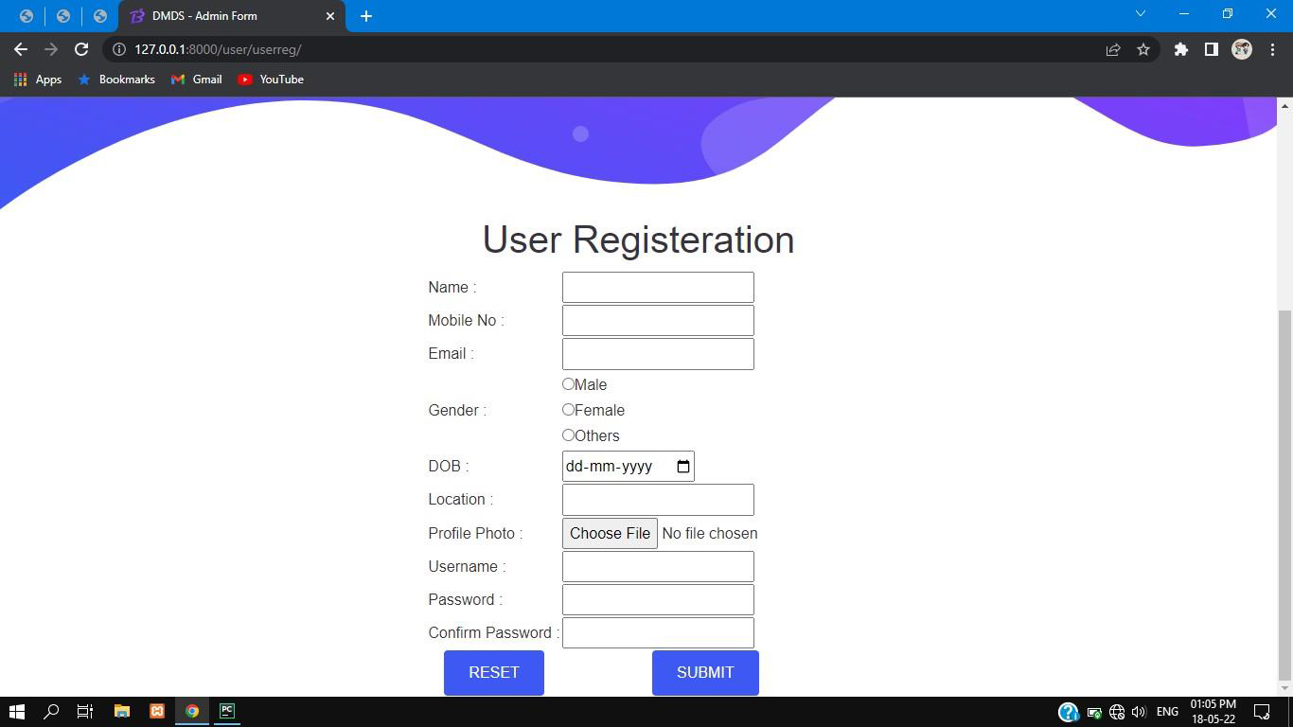
Screenshots

Slide 18
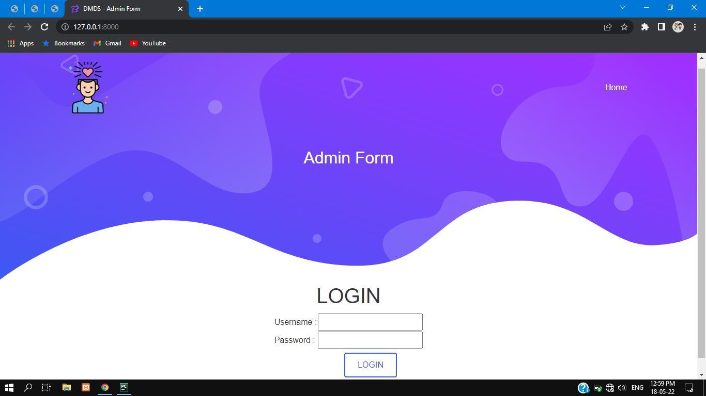

Slide 19
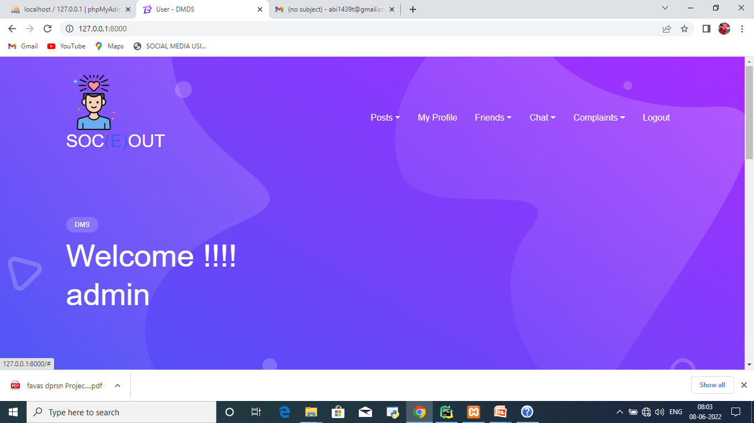

Slide 20
THANK YOU

